Slide 1







DESIGN AND IMPLEMENTATION OF DIGITALIZATION AND ARCHIVAL
SYSTEM USING BARCODE SCANNER FOR BAZE UNIVERSITY
BY
DAHIRU, Aisha Shettima
BU/22B/IT/6789

Slide 2





Introduction
This project designs a Digitalization and Archival System using a barcode scanner to streamline document management at Baze University. It replaces the inefficient manual process with a centralized platform, allowing secure access and storage of digital documents for students and administrators. The system improves retrieval speed, reduces paperwork, and enhances operational efficiency with role-based security. By adopting it, the university can modernize its record- keeping practices.

Slide 3






PROBLEM STATEMENT
Baze University faces inefficiencies in organizing, accessing, and preserving collections due to manual archival processes. The lack of modern technologies, like barcode scanning, further complicates work flows and access. To address these challenges, a comprehensive digitalization and archival system with barcode scanning is needed. This system should streamline digitization, improve data input and retrieval, and offer user- friendly interfaces for staff and researchers.

Slide 4

AIM AND OBJECTIVES
The aim is to develop a comprehensive digitalization and archival system utilizing barcode scanning technology.
The objectives of this project are:
To scan physical documents to create digitized documents.
To create respective QR code for efficient searching, sorting, and indexing.
To implement appropriate user access control.
To Implement measures to protect digital archives from unauthorized access, ensuring the confidentiality and integrity of sensitive information

Slide 5

SIGNIFICANCE OF THE STUDY
The project offers significant benefits:
Searching: Digital content can be quickly searched using keywords, speeding up information retrieval.
Accessibility: Digital archives allow remote access, enabling authorized personnel to retrieve data from anywhere, supporting collaboration and timely decision-making.
Security: With encryption and access controls, digital archives enhance security, protecting sensitive information like student and faculty records.

Slide 6
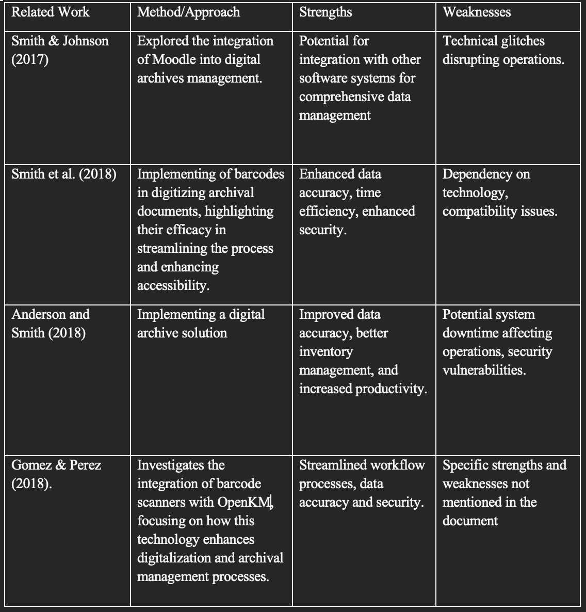
LITERATURE REVIEW

Slide 7
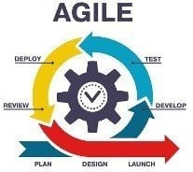

ADOPTED METHODOLOGY

Slide 8
WHY THE AGILE METHODOLOGY
This approach is straightforward to comprehend since each step has a distinct deliverable and review procedure, and each phase is done one at a time. Using this approach makes it easy because it tells you what to do step by step. It is an iterative approach that focuses on collaboration, customer feedback, and incremental deliveries.

Slide 9




TOOLS AND TECHNIQUES
HTML, CSS and JavaScript are used on
the front-end for structure, styling and interactivity. Laravel and MySQL are
used as back-end to store/access data from a database. Together these tools allow for complete web application development

Slide 10

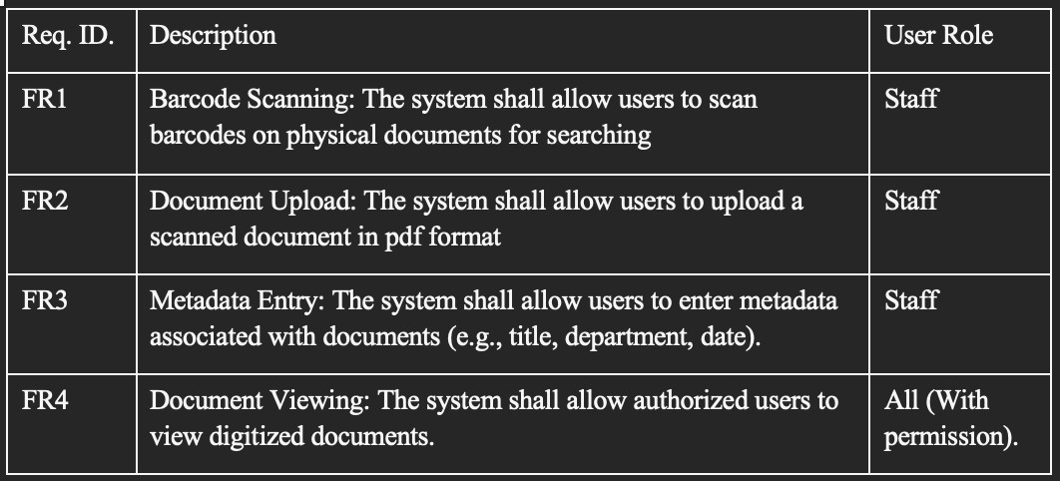
REQUIREMENT SPECIFICATIONS
Functional requirement

Slide 11
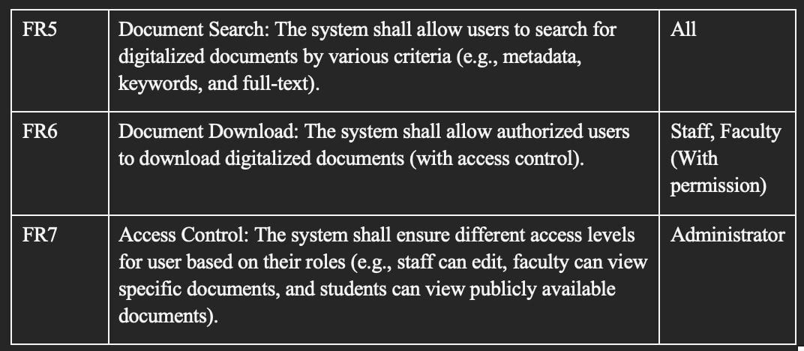
REQUIREMENT SPECIFICATIONS
Functional requirement continue

Slide 12
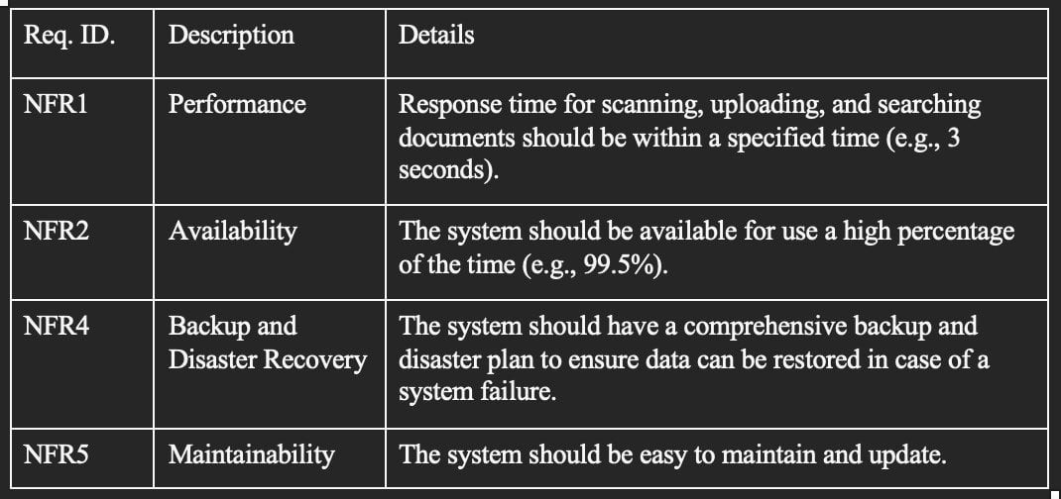
REQUIREMENT SPECIFICATIONS
Non-Functional requirement

Slide 13
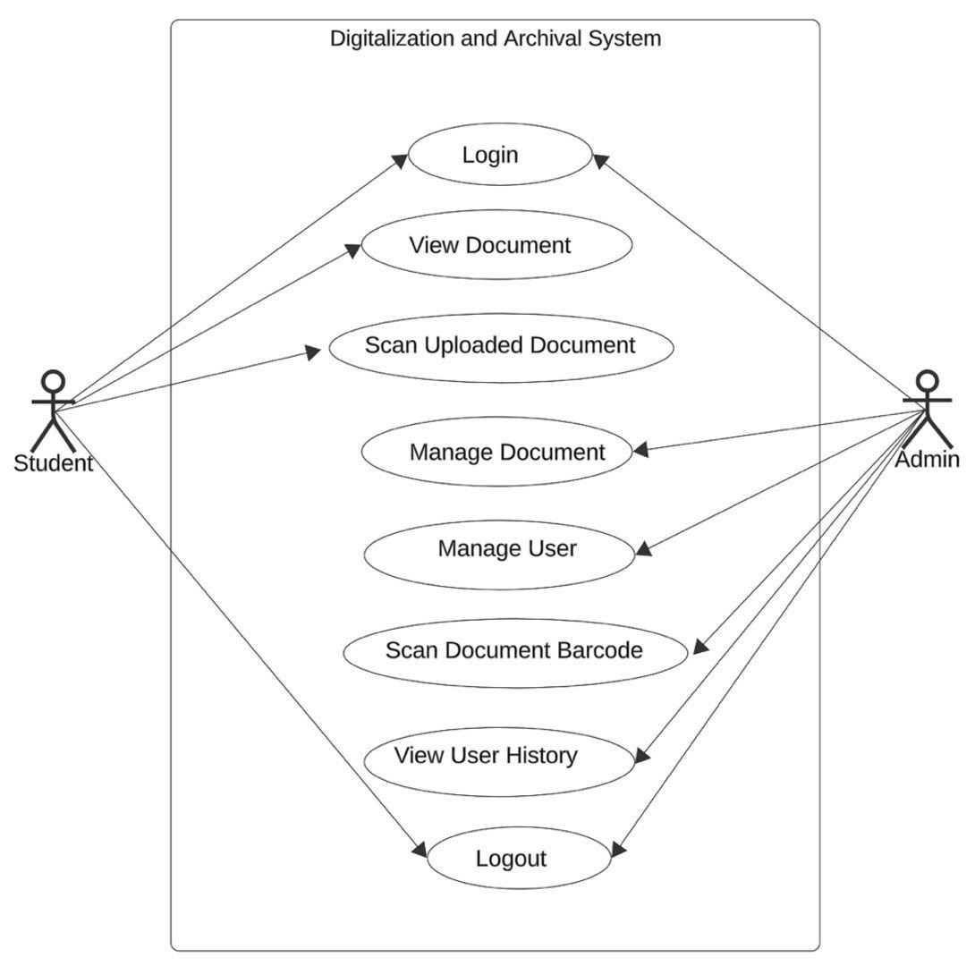
UML DIAGRAMS
Usecase Diagram

Slide 14
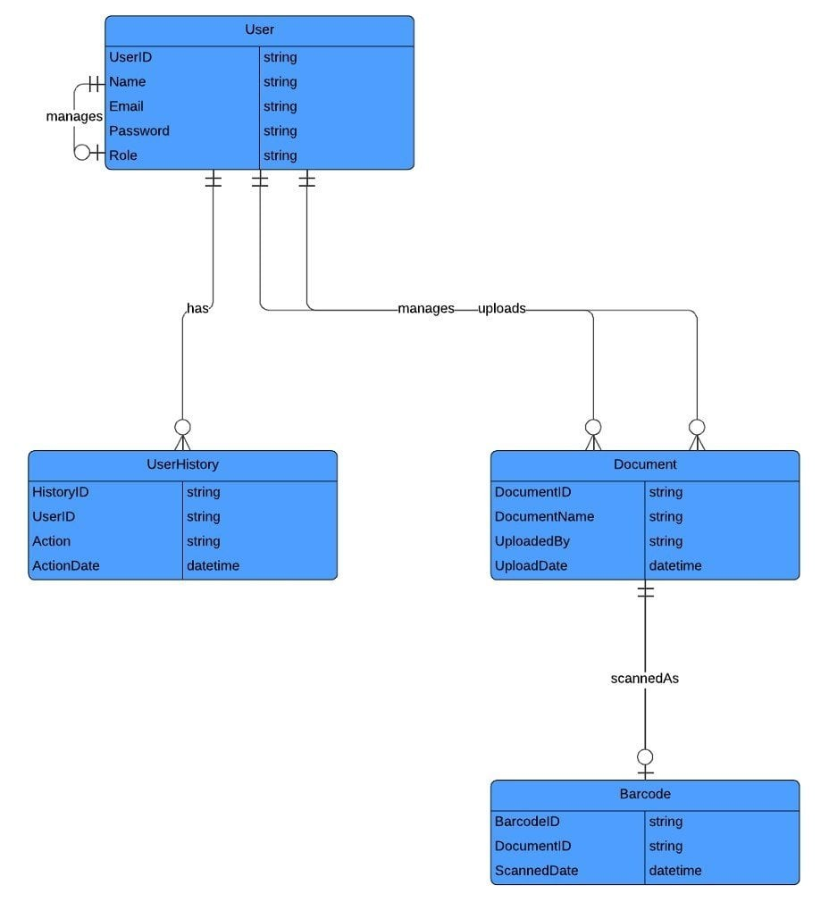
UML DIAGRAMS
ER Diagram

Slide 15
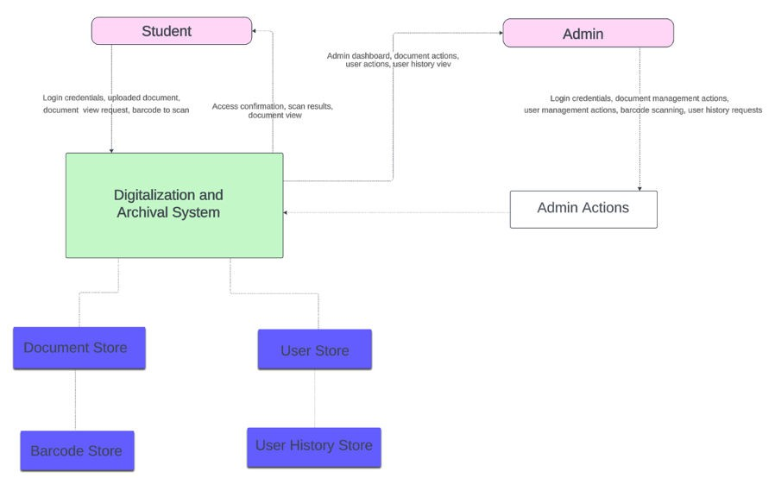
UML DIAGRAMS
Data Flow Diagram

Slide 16
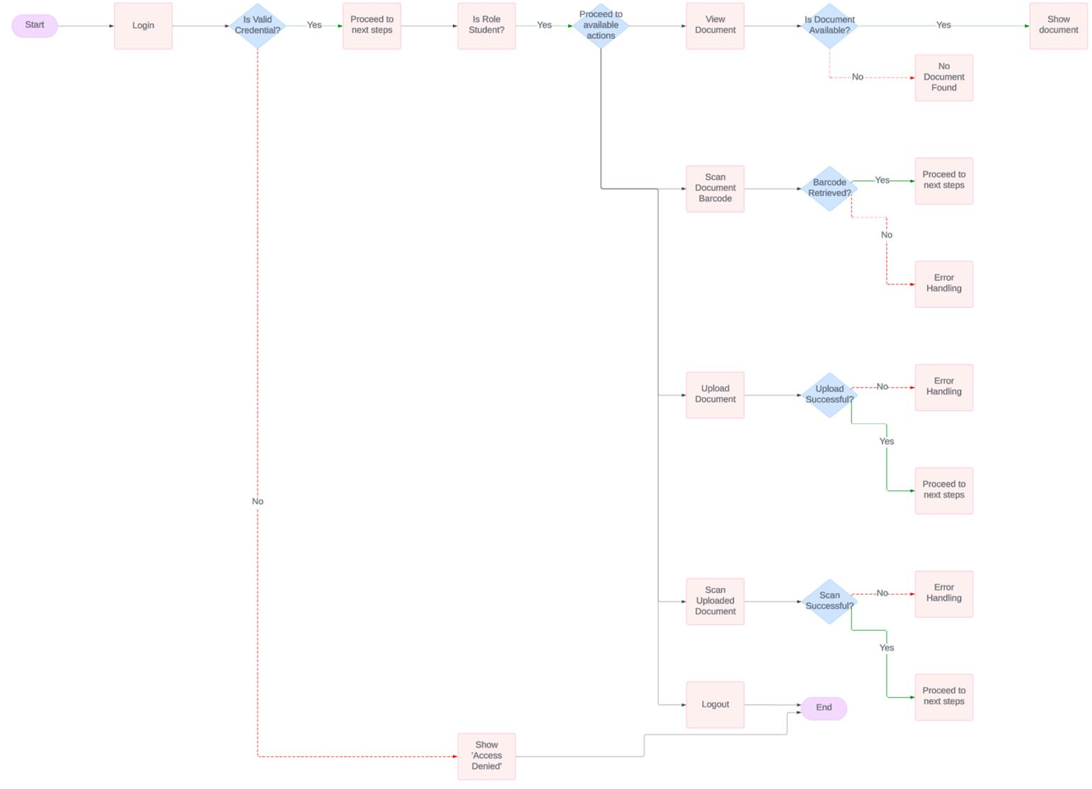
UML DIAGRAMS
Control Flow for Student

Slide 17
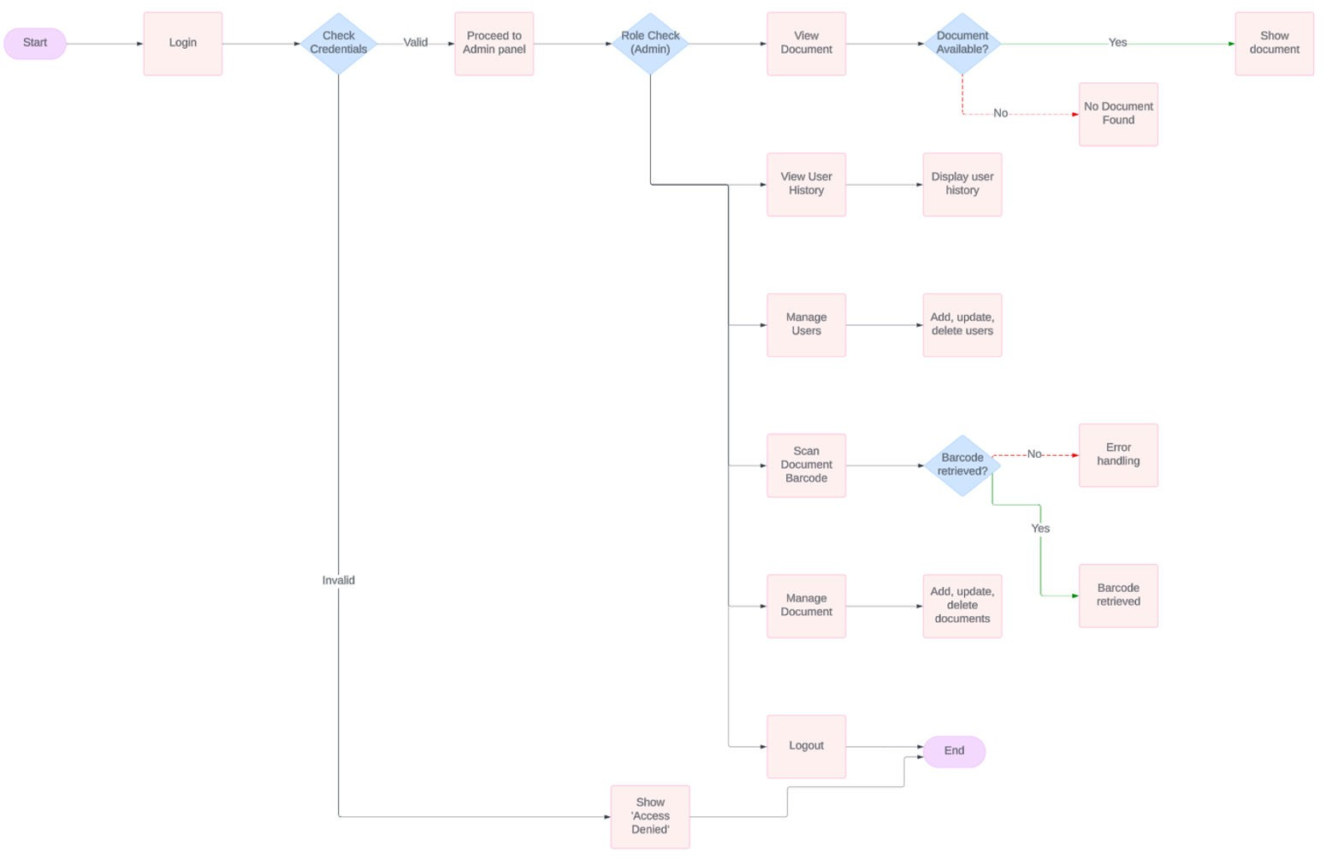
UML DIAGRAMS
Control Flow for Admin

Slide 18






TESTING
The testing phase is an essential part of software development that ensures the quality of the system. To ensure the reliability and functionality of the Application, a comprehensive testing strategy was employed.
The testing process involved the following phases:

Slide 19





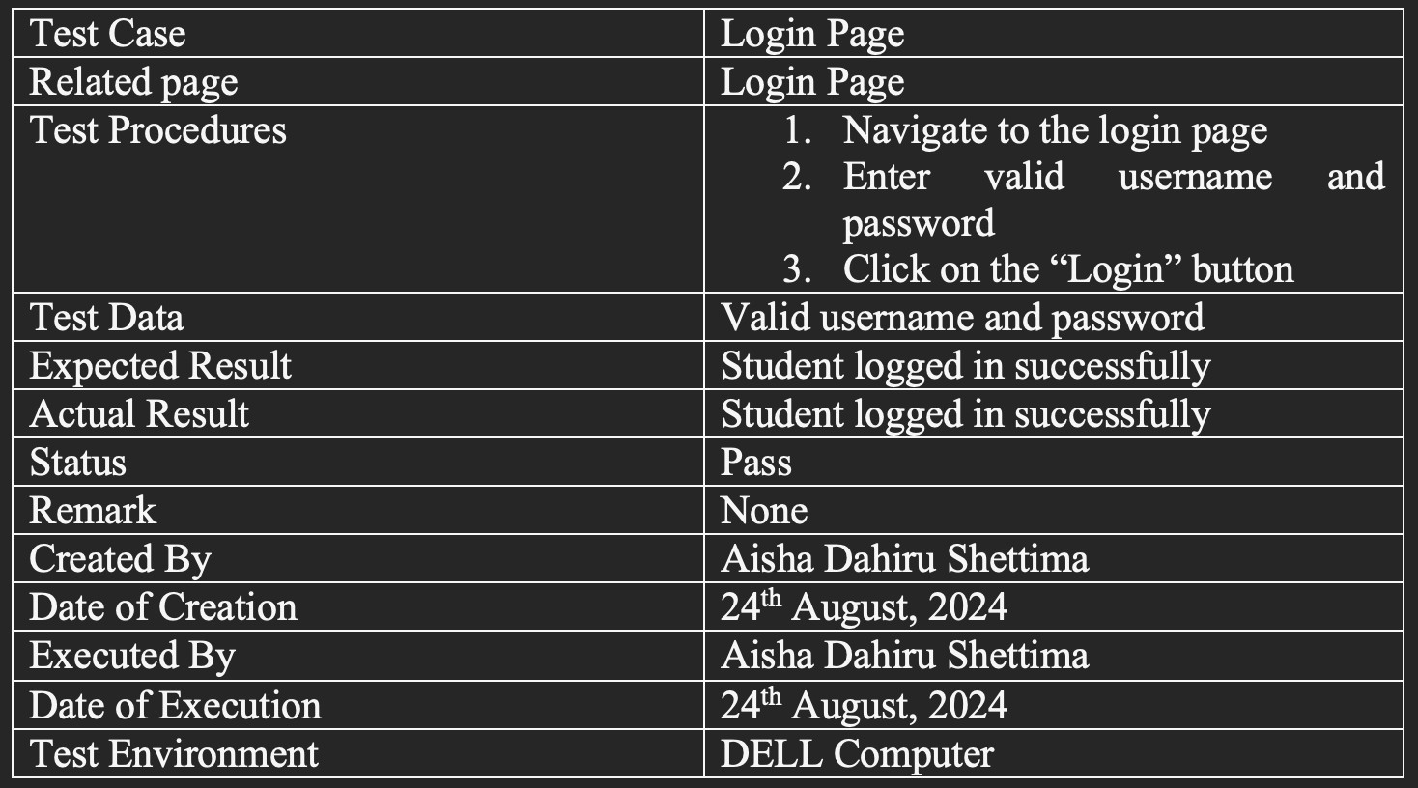
TESTING
Testing for Login

Slide 20
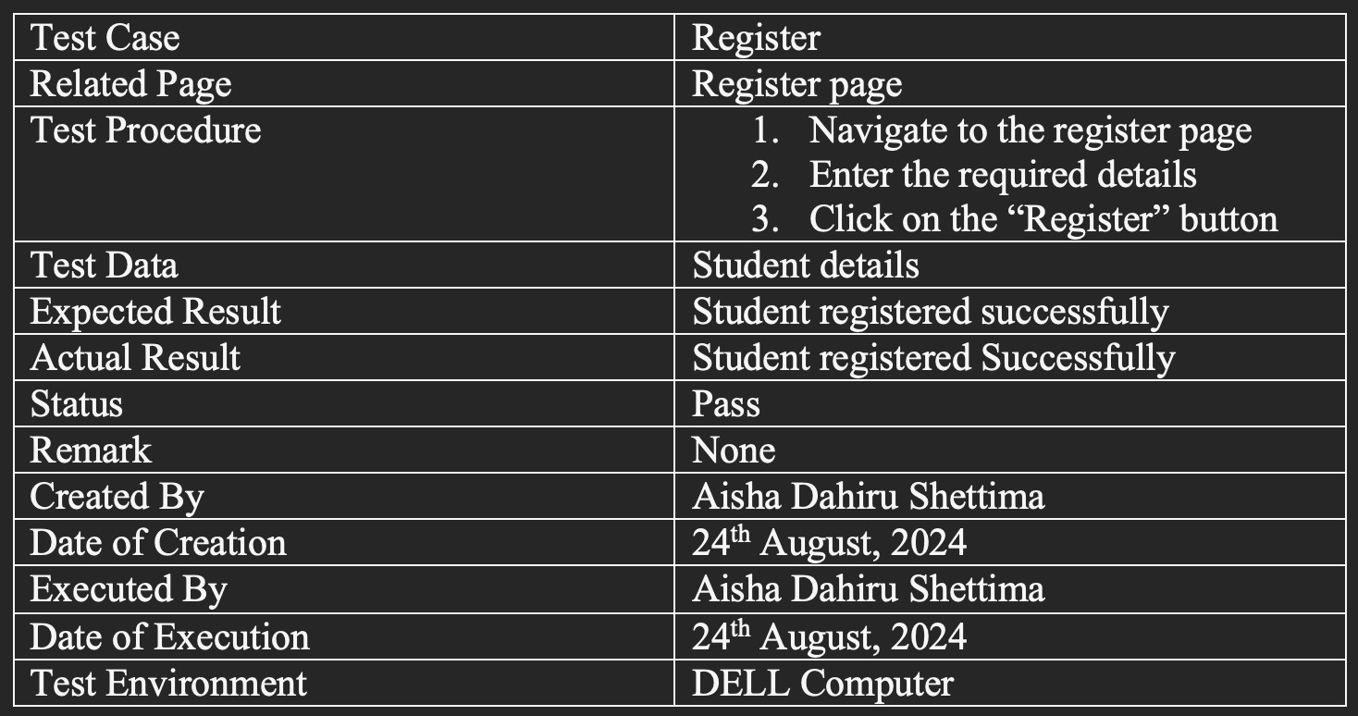
TESTING
Testing for Register

Slide 21
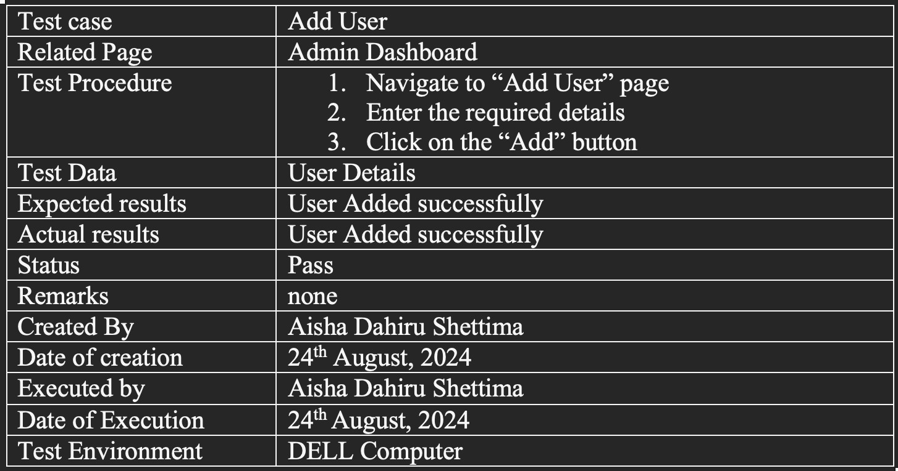
TESTING
Testing for add User

Slide 22
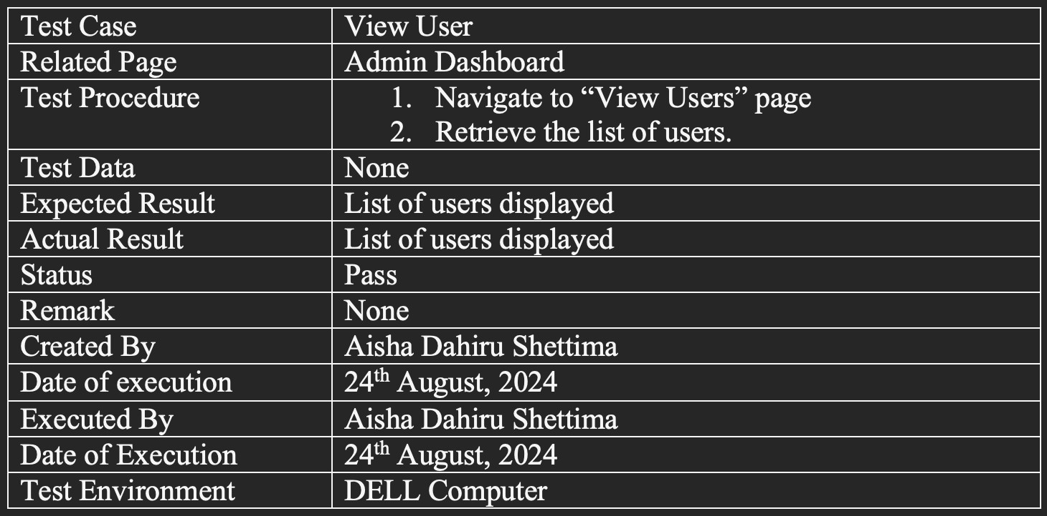
TESTING
Testing for view Users

Slide 23
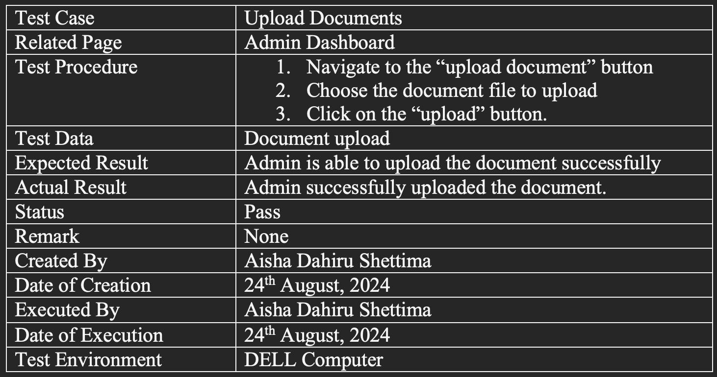
TESTING
Testing for Document Upload

Slide 24
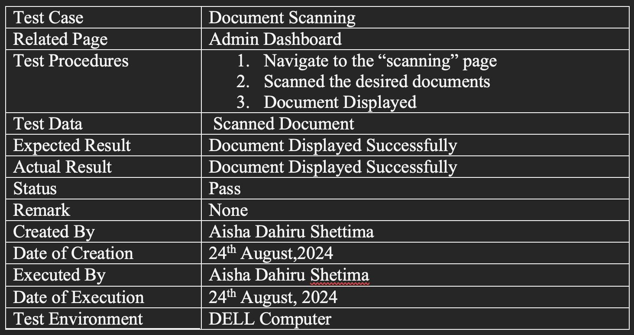
TESTING
Testing for Document Scanning

Slide 25
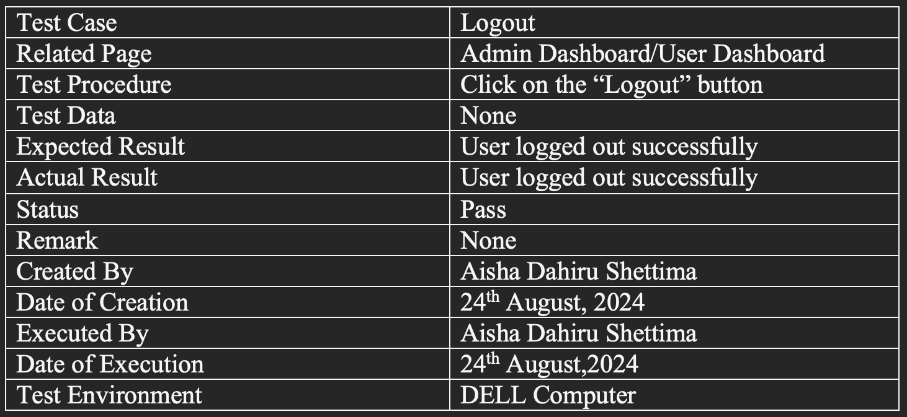
TESTING
Testing for Logout

Slide 26





System Demo

Slide 27



Conclusion
In conclusion, the barcode-enabled Digitalization and Archival System enhances Baze University's document management by improving efficiency, reducing document loss, and speeding up retrieval. With secure, role-based access, it modernizes
academic | and | administrative record handling, | promoting | a | shift
towards | more | efficient digital practices.

Slide 28
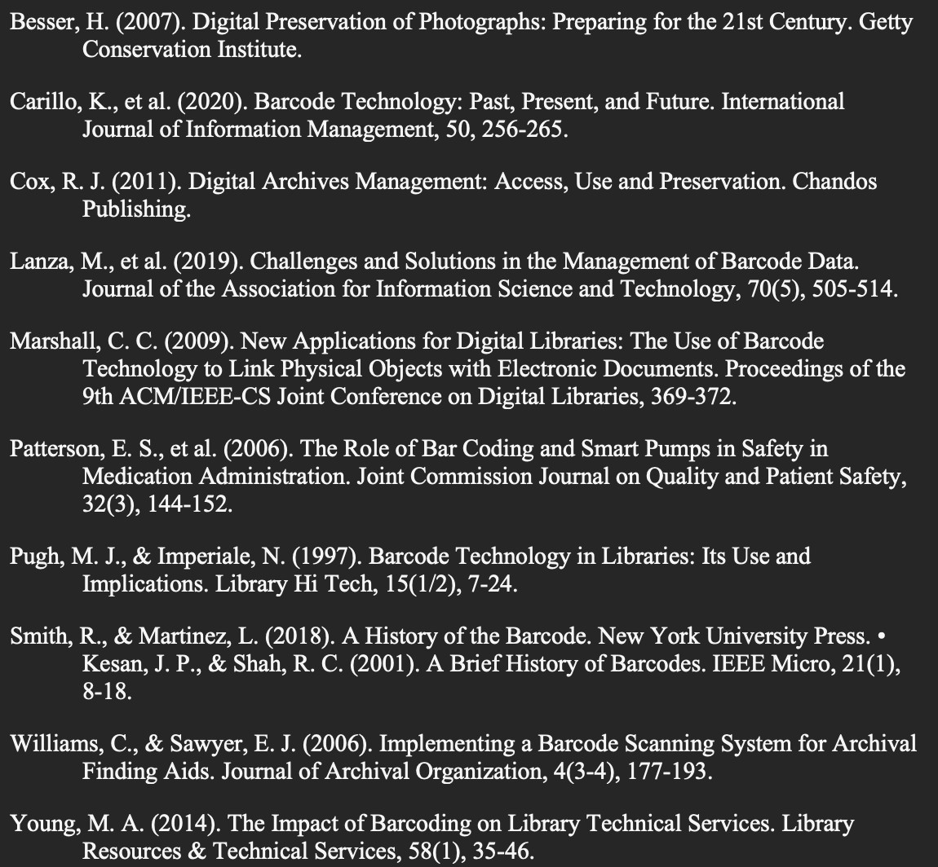
REFERENCES

Slide 29








Thank
You!

